Slide 1

Medical AI Research: Predicting perioperative blood transfusion for CABG patients
Capstone Final Presentation, May 2, 2024
Team: Jenny Tsai ¹ & Jichong Wu ¹
Collaborator: Dr. Puneet Gupta ²
Advisor: Professor Amir Jafari ¹
¹ George Washington University
² George Washington University Hospital

Slide 2

Overview
Introduction
Data Preprocessing
Analysis Strategy
Results
Phase 1: Classical models
Phase 2: Neural networks
Conclusions

Slide 3
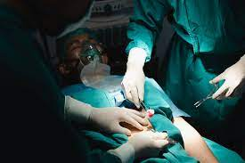
Introduction
1,452 × 966
Coronary Artery Bypass Graft (CABG) is a common cardiac surgery
May cause major bleeding which needs blood transfusion
Blood transfusion is associated with:
Higher risks of mortality after surgery
Higher odds of readmission and heart failure within 30 days

Slide 4

Research Gap
Previous research*:
A single cardiac surgery center in Austria
N = 3782 (2010-2019)
Random Forest:
AUC: 0.76-0.86
In the current project:
US national database ACS NSQIP
N = 13534 (2015-2022)
Basic models + Neural networks + Feature engineering/selection + data synthesis
*Tschoellitsch et al. (2022)
Notes:
Lots of research has been done to explore factors that can help to predict the need for blood transfusion, but often with limitations. For example…

Slide 5
Objectives
Develop models that can best predict which CABG patients need blood transfusion
Improve patient selection and education
Enhance physician preoperative awareness
Inform periop guidelines for CABG patients
Experiment with different DS techniques (e.g., feature selection, feature engineering, synthetic data) applied in basic and advanced models to achieve best outcomes
Develop a full set of modules that can be reused in the future, which covers preprocessing, feature selection and feature engineering, and modeling
Notes:
Objectives of the our project are three-fold.

Slide 6
Data Preprocessing
Datasets
Participant Use Data File (PUF) on the American College of Surgeons National Surgical Quality Improvement Program (ACS NSQIP)
Year 2015 - 2022 (N = 13534, # of features = 296)
Key preprocessing steps:
Basic clean-up (e.g., recode values, correct data type)
Remove columns with over 50% missing values
Impute with mean (numeric) and most frequent values (categorical)
Standardize all numeric features
Remove post-operative and irrelevant features by expert
Final dataset size:
N = 13534, # of features = 41

Slide 7

Phase 1: Classcial Models

Slide 8
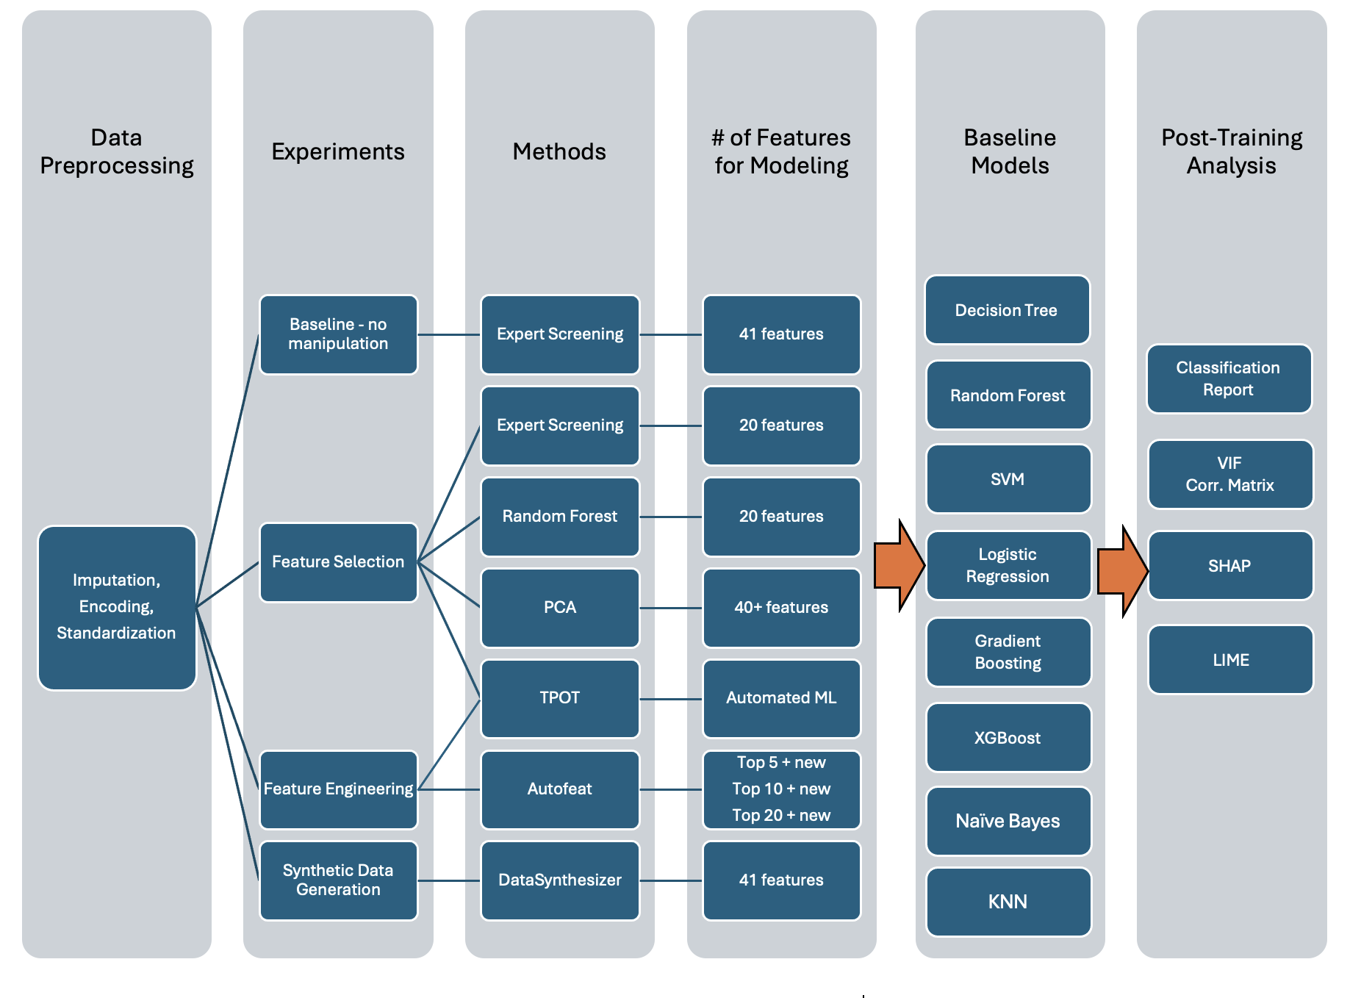
Analysis
Strategy

Slide 9
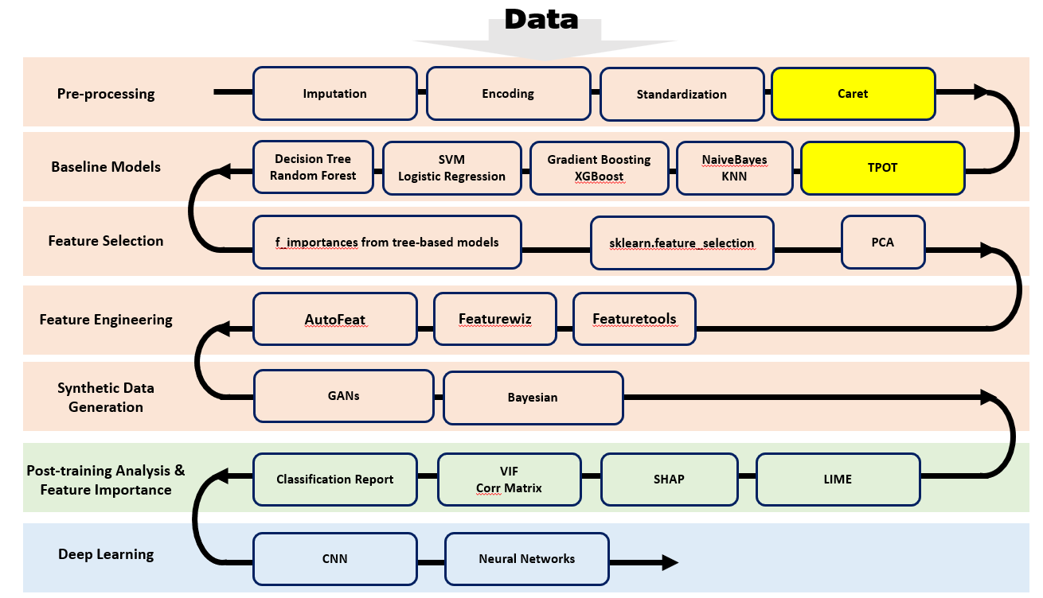
Analysis Strategy
Notes:
Please remove GANs as Prof. says it’s not easy to train and is not as powerful as realtabformer.

Slide 10
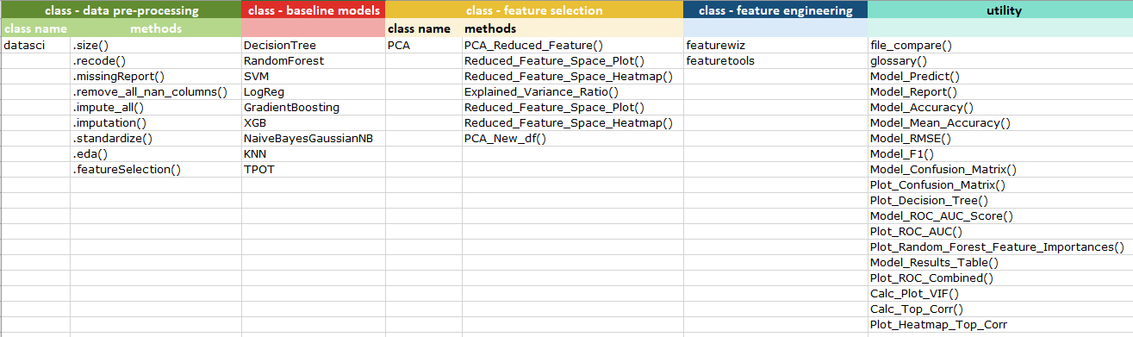
Modules and Utilities

Slide 11
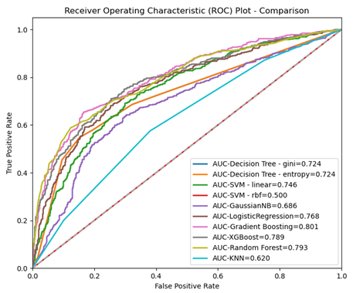
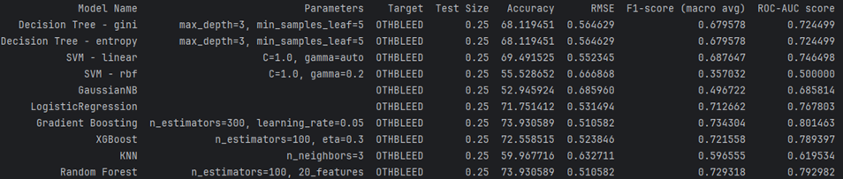
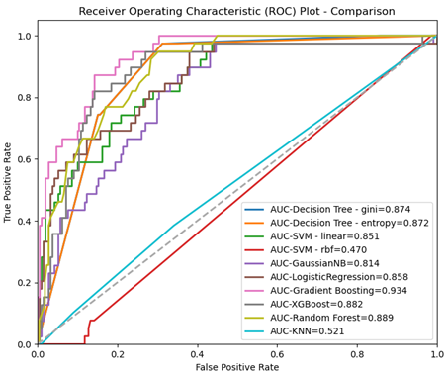
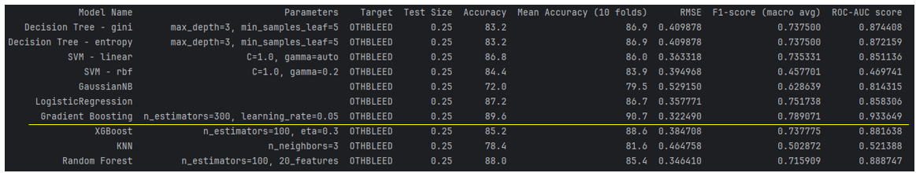
Model Results

Slide 12
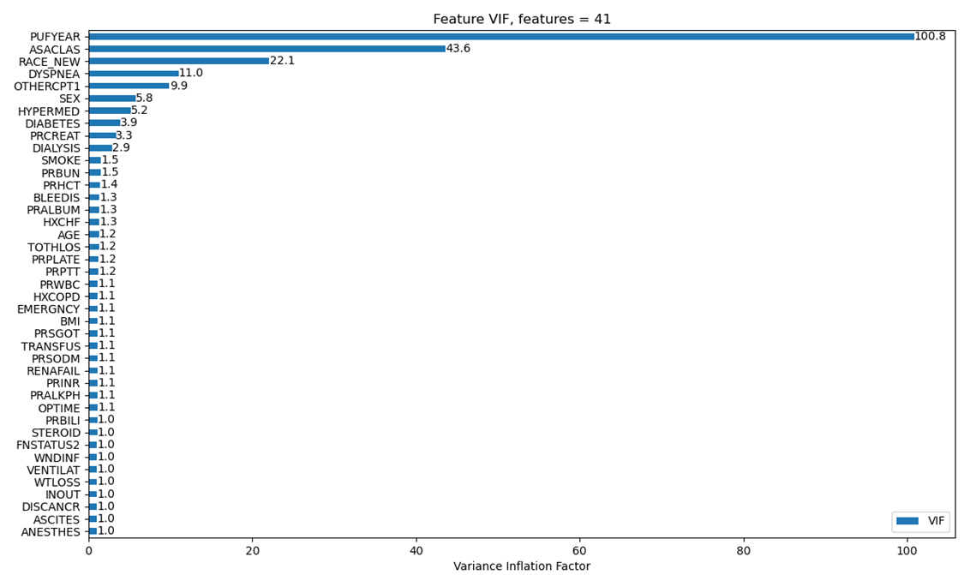
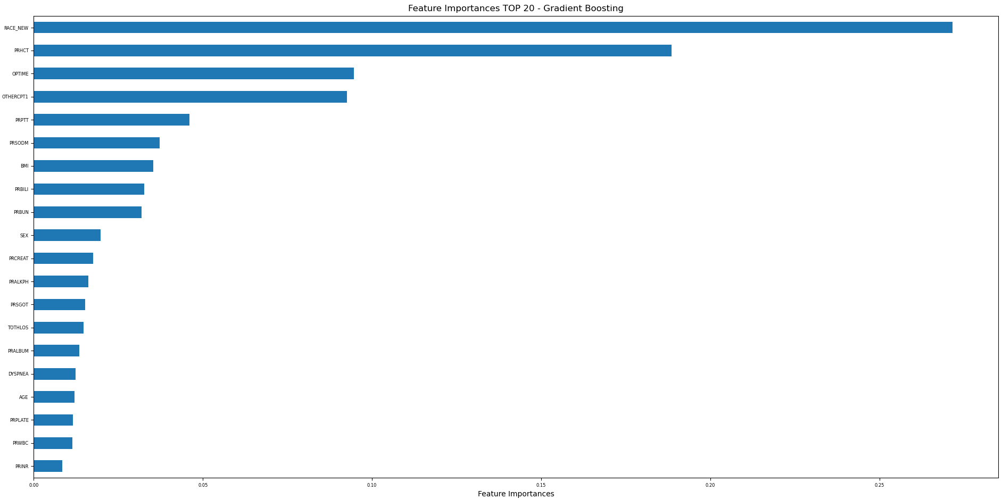
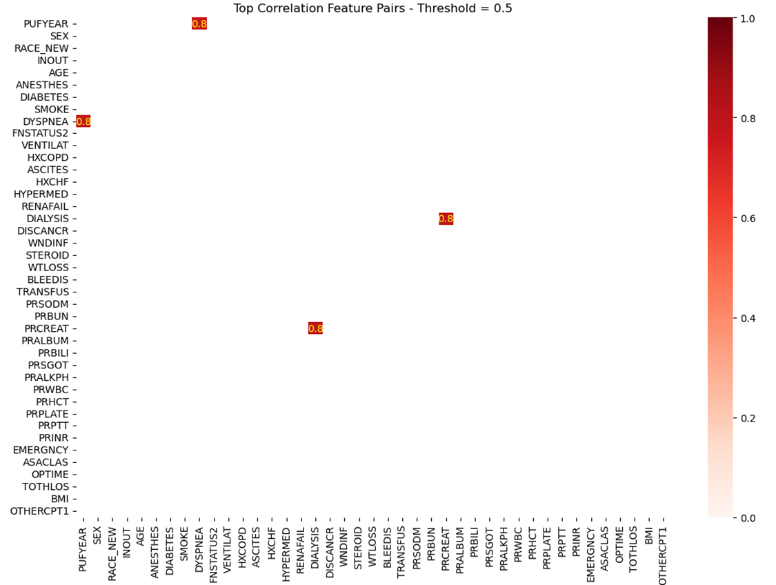
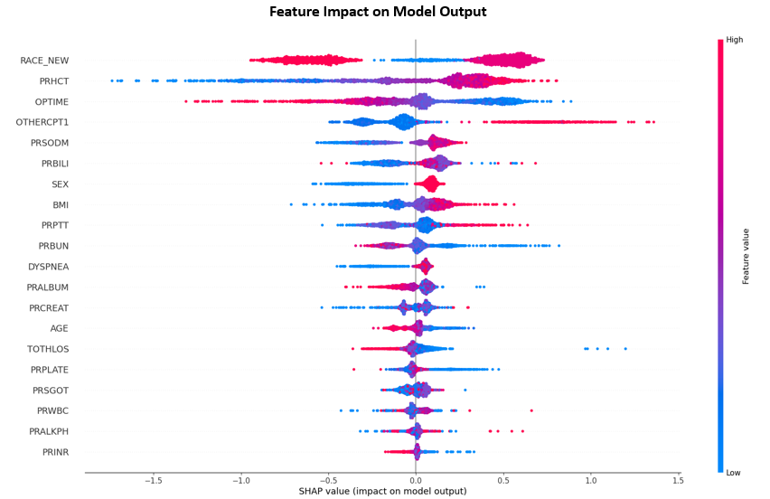
Post-training Analysis

Slide 13
Phase 1 modeling summary
PUFYEAR, ASACLAS, RACE_NEW may cause multicollinearity.
Gradient Boosting, XGBoost, Random Forest perform the best.
Synthetic data generation techniques (DataSynthesizer using Bayesian networks) significantly improve model performance.
Race, days from preoperative labs to operation, operation time, other procedure, BMI, sex, length of hospital stay, shortness of breath, age, preoperative blood test measures
days from preoperative labs to operation, operation time may have a negative impact on model results while other procedure, BMI have a positive effect.

Slide 14
Phase 2: Neural Networks

Slide 15
Major Types of Artificial Neural Networks
FNNs are simpler type of neural network where data and information flows in one direction from input layer to output layer.
RNNs are designed for sequential data processing, where the output at each step depends not only on the current input but also on previous inputs in the sequence. They are commonly used for tasks like natural language processing (NLP), time series analysis, and speech recognition.
CNNs are designed for processing grid-like data such as images. They use convolutional layers to detect patterns and features in the input data, making them highly effective for tasks like image recognition and object detection.
LSTMs are a type of RNN designed to address the vanishing gradient problem and handle long-term dependencies in sequential data. They are particularly effective for tasks that require capturing long-term patterns and dependencies, such as machine translation, sentiment analysis, and time-series modeling.
GANs consist of two neural networks, the generator and the discriminator, that are trained together in a competitive setting to create new data from a given training dataset. The generator creates new data samples, while the discriminator distinguishes between real and generated samples. GANs are typically used for image generation and data augmentation.
RBFNs use radial basis functions as activation functions and are distinguished from other neural networks due to their universal approximation and faster learning speed.

Slide 16
Literature Review on Related Work
Deep neural networks models have shown excellent performance and especially when processing complex data such as image, text and sound. However, their adaptation to tabular data tasks remains highly challenging
No sufficient evidence that neural networks are better than classical models such as gradient boosting decision trees
Gradient boosting methods outperform NNs
A hybrid approach of gradient boosting plus deep neural networks performs the best

Slide 17
Synthetic Data Tools
DataSynthesizer
Based off Bayesian Networks, which represents a graphical model of the joint probability distribution for a set of attributes
Probabilistic inference about one attribute in the network given the values of other attributes → missing data imputation, synthetic data generation
Three modules: DataDescriber, DataGenerator, ModelInspector
REaLTabFormer (Realistic Relational and Tabular Data using Transformers)
Relational data: A sequence-to-sequence (Seq2Seq) model
Non-relational data: GPT-2

Slide 18
Feedforward Neural Networks (FNNs)
FNN Design
8 models varying in:
Complexity (# of layers, # of neurons)
Output activation function (sigmoid vs. softmax)
Loss function (binary vs. categorical cross entropy)
Optimizer (SGD vs. Adam)
Datasets
Original
REaLTabFormer
DataSynthesizer

Slide 19
FNNs with Original Data
Model | accuracy | f1_score | rMSE | AUC
FNN-5layer-SGD-sigmoid | 0.7215 | 0.6888 | 0.4794 | 0.7764
FNN-5layer-Adam-sigmoid | 0.7218 | 0.6961 | 0.4928 | 0.7756
FNN-7layer-SGD-sigmoid | 0.7174 | 0.6954 | 0.4850 | 0.7741
FNN-7layer-Adam-sigmoid | 0.7174 | 0.6782 | 0.5735 | 0.7752
FNN-5layer-SGD-softmax | 0.7229 | 0.7200 | 0.4643 | 0.7782
FNN-5layer-Adam-softmax | 0.7218 | 0.7179 | 0.4975 | 0.7815
FNN-7layer-SGD-softmax | 0.7181 | 0.7150 | 0.4780 | 0.7780
FNN-7layer-Adam-softmax | 0.7185 | 0.7118 | 0.5587 | 0.7766

Slide 20
2. FNNs with Synthetic Data - REaLTabFormer
Model | accuracy | f1_score | rMSE | AUC
FNN-5layer-SGD-sigmoid | 0.7362 | 0.7420 | 0.4789 | 0.8006
FNN-5layer-Adam-sigmoid | 0.7359 | 0.7394 | 0.4650 | 0.8007
FNN-7layer-SGD-sigmoid | 0.7303 | 0.7392 | 0.4819 | 0.7939
FNN-7layer-Adam-sigmoid | 0.7351 | 0.7315 | 0.5577 | 0.7972
FNN-5layer-SGD-softmax | 0.7381 | 0.7380 | 0.4506 | 0.8008
FNN-5layer-Adam-softmax | 0.7355 | 0.7355 | 0.4698 | 0.7999
FNN-7layer-SGD-softmax | 0.7362 | 0.7362 | 0.4787 | 0.7995
FNN-7layer-Adam-softmax | 0.7303 | 0.7286 | 0.5575 | 0.7934

Slide 21
3. FNNs with Synthetic Data - DataSynthesizer
Model | accuracy | f1_score | rMSE | AUC
FNN-5layer-SGD-sigmoid | 0.8718 | 0.8776 | 0.6790 | 0.9386
FNN-5layer-Adam-sigmoid | 0.8689 | 0.8772 | 0.4340 | 0.9474
FNN-7layer-SGD-sigmoid | 0.8685 | 0.8774 | 0.5853 | 0.9358
FNN-7layer-Adam-sigmoid | 0.8626 | 0.8712 | 0.4222 | 0.9456
FNN-5layer-SGD-softmax | 0.8751 | 0.8749 | 0.6119 | 0.9421
FNN-5layer-Adam-softmax | 0.8696 | 0.8696 | 0.4286 | 0.9495
FNN-7layer-SGD-softmax | 0.8762 | 0.8762 | 0.5596 | 0.9401
FNN-7layer-Adam-softmax | 0.8670 | 0.8667 | 0.4513 | 0.9474

Slide 22
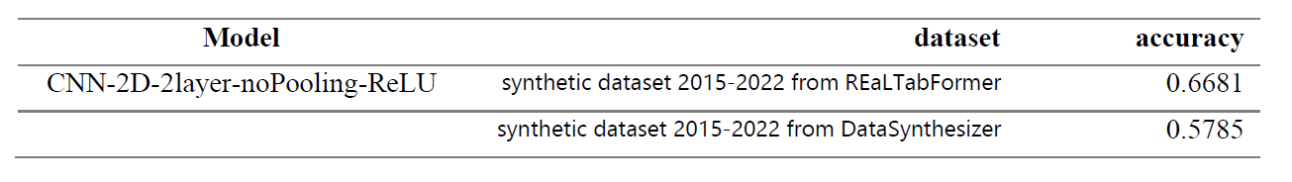
4. CNNs with Synthetic Data

Slide 23
Conclusion
For both classical models and neural networks, best performance was found in models using synthetic data from DataSynthesizer
Bayesian networks might have some systematic influence on optimizers
Compared with FNNs, CNNs might not be suitable for analyzing tabular data

Slide 24
Thank You!

